Slide 1


SAP UI5 & FIORI with OData TRAINING
Anubhav Oberoy
Day – 9

Slide 2

Agenda – Day 9
Concept of Base Controller
Formatter in UI5
User Experience and User Interface
Introduction to Fiori
Structure of a fiori Project
Understanding the Component.js
Creating Component JS
Working with Multiple Views
Navigation between views
Introduction to manifest.json
Understanding the structure of manifest.json
Introduction to List Control in UI5
Types of List Control
Binding of List control
Understanding the List Modes
Understanding how to search data using Search Field
Introduction to the Data Filtering
Adding toolbar in the application.
Showing a Message Box.
Introduction to Worklist Fiori Application

Slide 3

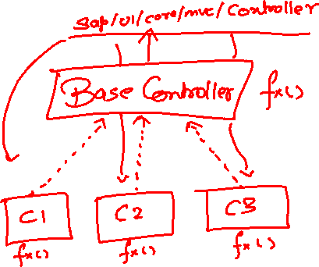
Exercise: Base Controller
In this exercise we will create a new BaseController.
Along with that we will see how to load data to a model from a file.
Exercise code/resources: -
MyView.view.xml
MyView.controller.js
BaseController.js

Slide 4
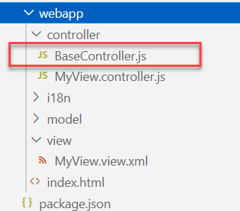
Concept of Base Controller in UI5
Base Controller:- A base controller is a controller with basic functionalities from which the other controllers in your SAPUI5 application inherit.
The base controller holds basic functionalities that are used across multiple controllers.
The base controller itself is just another JavaScript file and it does not have the .controller prefix. Just BaseController.js and not BaseController.controller.js.
The base controller goes in the controller folder in your SAPUI5 application folder structure:
sap/ui/core/mvc/Controller
x
BaseController
Template
x
Controller 1
x
Controller 2
x
Controller 3
x
Controller 4
View 1
View 2
View 3
View 4

Slide 5
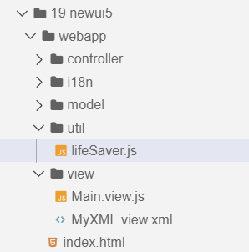
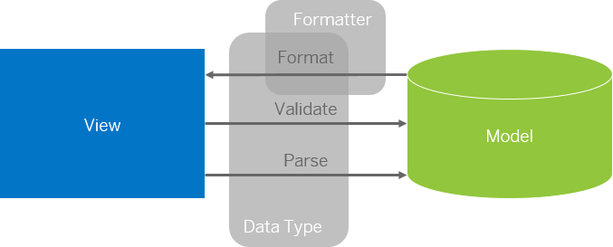
Formatter in SAP UI5
Formatters are used to define the formatting of data on the UI while data types work in both directions: they format the data on the UI and parse and validate user input that is entered.
Formatter is a function; This function gets called JUST Before the binding takes place with the view.
Formatter file is placed in a folder in webapp folder, and the file can be named anything with the .js extension.
Formatter

Slide 6

Exercise: Formatter
In this exercise we are going to currency code in the table.
We will convert the currency code into its corresponding currency symbol.
We will achieve this by using a formatter function.
Exercise Code:-
MyView.view.xml
MyView.controller.js
lifeSaver.js

Slide 7
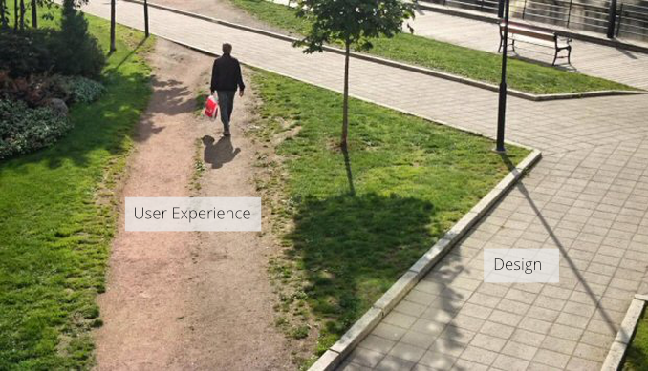
User Experience v/s User Interface
User interface is developer oriented. This is purely technical. We can change UI any number of times.
User experience is user oriented. It is psychological. We cannot change UX.

Slide 8
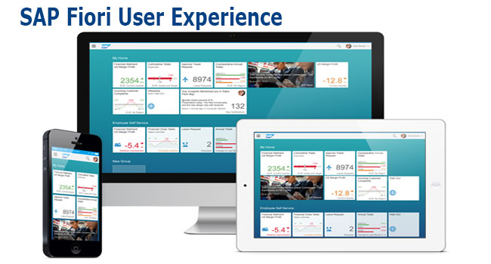
What is Fiori?
SAP Fiori is the user interface or user experience (UX) that supplements and can replace the SAP GUI. This streamlined application uses tiles to encapsulate standard tasks, such as approving purchase requisitions, viewing sales orders, and approving timesheets.
Fiori is SAP’s new user experience. These are standard apps delivered by SAP and by following the Development guidelines any one can use UI5 to create Fiori Apps.
Fiori is a streamlined application, delivering a role-based user experience that can be personalized across all lines of business, tasks and devices.
It uses tiles to encapsulate standard tasks like viewing sales orders or approving timesheets.
Fiori = UI5 + Development/Design Guidelines

Slide 9
Structure of a Fiori project
There are different folders and directory are required for setup project: webapp, Controller, models, utils ,view, Component.js, manifest.json, index.html
Structure of normal ui5 application
Index.html
View
Controller
Structure of Fiori Application
Dev.
sap/ui/core/UIComponent
Index.html
Root View
App.view.xml
Component.js
View 1
Controller 1
Container
App (pages)
View 2
Controller 2
manifest.json
App descriptor
App.controller.js
BaseController
Component.js is starting point

Slide 10
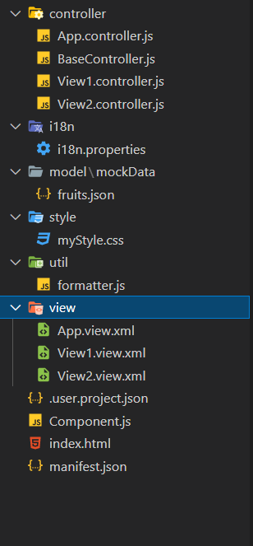
Structure of Fiori Project Files
There are different folders and directory are required for setup project
Webapp = This provides the root directory and of all files given in alias name or namespace
Controller = The controller folder contains all the controllers used by your views and might also contain additional logic files that are used by one or more controllers. The structure of the controller folder should mirror the view folder.
models = It contains .json file and object of data
utils = It is the reuse file of JS code
view = It contains all the .xml files.
Component.js = It is the starting file of our app
manifest.json = It is the application descriptor file.
Index.html

Slide 11
Structure of a Fiori project
There are different folders and directory are required for setup project: webapp, Controller, models, utils ,view, Component.js, manifest.json, index.html
Structure of normal ui5 application
Index.html
View
Controller
Structure of Fiori Application
Dev.
sap/ui/core/UIComponent
Index.html
Root View
App.view.xml
Component.js
View 1
Controller 1
Container
App (pages)
View 2
Controller 2
manifest.json
App descriptor
App.controller.js
BaseController
Component.js is starting point

Slide 12
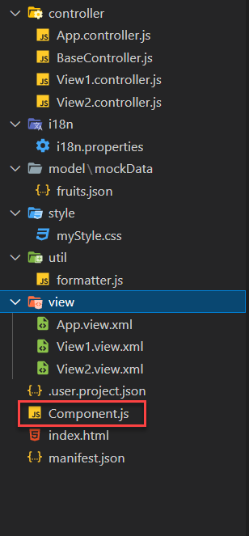
What is Component.js
Component.js the starting point of ANY Fiori app. If an app has Component.js inside, it called Fiori like app.
The Component.js file is the component controller and provides the runtime metadata and the component methods.
It is the wrapper of all the functionality. We never start any productive code in index.html, rather its all kept in Component.js
It is a class which inherits from sap/ui/core/UIComponent standard class. We inherit to reuse the functionality offered by SAP like routing.
When app starts, UI5 framework will scan your project’s base directory to check if it has a file with exact name Component.js
The component file calls the manifest file, and we keep all app level configuration inside the manifest file.
It is also important from the point of view that we will instantiate all models for our application inside the manifest file. The model instantiated in manifest file are directly set on the component and not on the root view.

Slide 13
Skeleton of Component.js
The Component.js is consists of 4 sections
metadata
init()
destroy()
createContent()
The metadata section. It has property key manifest and value json. This property calls the manifest.json file which is also know as the app descriptor file. It holds all app level configuration and helps keep our Component file clean thereby clearly separating application coding from configuration settings.
Another section of component file is the init function that is called when the component is initialized. When the component is instantiated, the init function is automatically invoked.
sap.ui.define([
'sap/ui/core/UIComponent'
], function(UIComponent) {
'use strict';
return UIComponent.extend("anubhav.app.Component",{
metadata: {},
init: function(){
},
createContent: function(){
},
destroy: function(){
}
});
});

Slide 14

Exercise: First Fiori App
In this exercise we will create a new project folder, in that folder we will add new ui5 project with an App view and a View1, and we will add a Component folder in the webapp folder.
Exercise code/resource:
firstfioriapp
webapp
controller
App.controller.js
BaseController.js
View1.controller.js
view
App.view.xml
View1.view.xml
Component.js
index.html
manifest.json

Slide 15
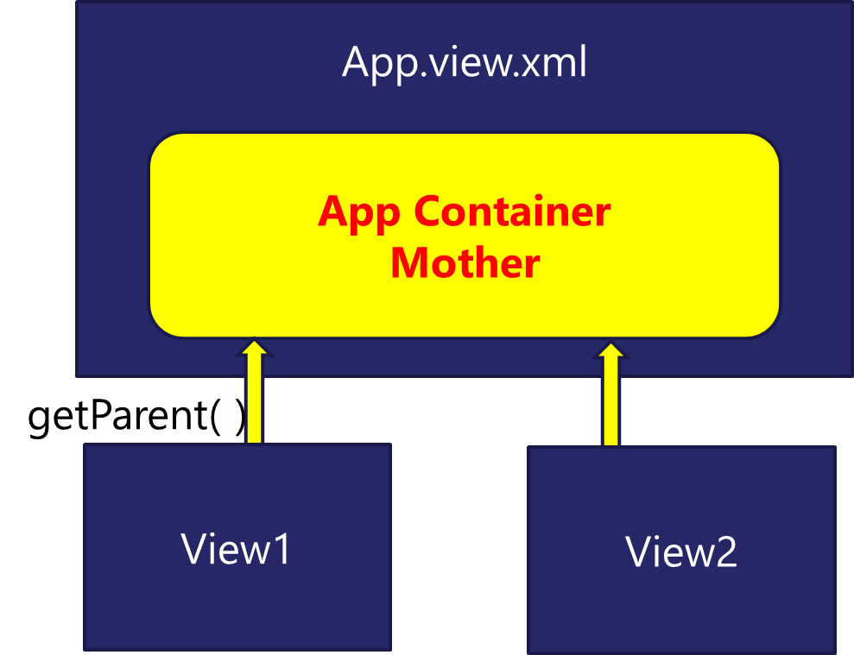
Working with multiple views in Fiori
Most of the Fiori app developed in the industry used to have more than one view. To work with multiple views, we use the concept of Parent View in the Fiori application. Which means all the views are loaded in one Parent View(App View) which then calls the view we want to display to the user.

Slide 16

Exercise: Working with multiple View
In this exercise we will add a New view in our existing application and will add button to our View1 to navigate to the View2.
Exercise code/resource:-
View1.view.xml
View1.controller.js
View2.view.xml
View2.controller.js
Component.js

Slide 17
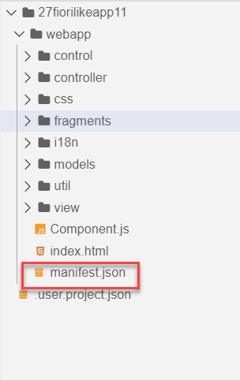
Concept of manifest.json in UI5
manifest.json is also knows as application descriptor file. It contains all the configuration for our app centrally.
Some attributes in the descriptor are just for information purposes, such as the minimum OpenUI5 version (minUI5version), others help external components (for example the SAP Fiori launchpad (FLP)) to integrate the application correctly, but most of the attributes are actually used to configure specific aspects of the app that are needed frequently.
It is written in JavaScript Object Notation (JSON) format.
We recommend that you use the manifest.json file to configure the app settings and put
all important information needed to run the app in there. Using this approach means
you need to write less application code, and you can already access the information
before the app is instantiated.
Everything which is needed for an app to start, load, move, run, configure,
requires is inside manifest.json.

Slide 18
Three Sections of manifest.json
sap.ui5 contains different components
rootView, dependencies, contentDensities, models, routing etc.
sap.ui5
sap.app contains idtype, i18n, applicationVersion, title, description, dataSources.
sap.app
sap.ui contains technology, icons, deviceTypes, supportedThemes
sap.ui

Slide 19
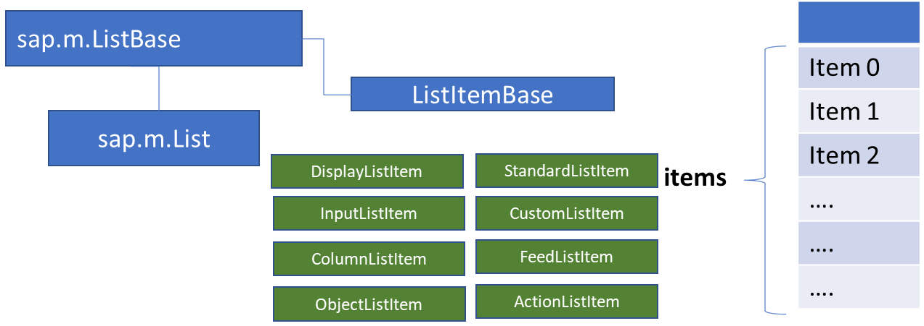
List Control
The list contains various list items. These items can be of various types depending on the use case and on the content they have. SAPUI5 already provides the most common list items in SAP Fiori in the form of controls, although custom list items can also be created if necessary.
Reference: https://sapui5.hana.ondemand.com/#/entity/sap.m.List
A List control is a single column table with multiple items inside. We will have a list header and items as aggregation.

Slide 20

Exercise: Basic List Controls
In this Exercise we will add some commonly used list controls to the view. We will also see how to use the samples given in the UI5 SDK.
Exercise code/resource:-
View1.view.xml

Slide 21
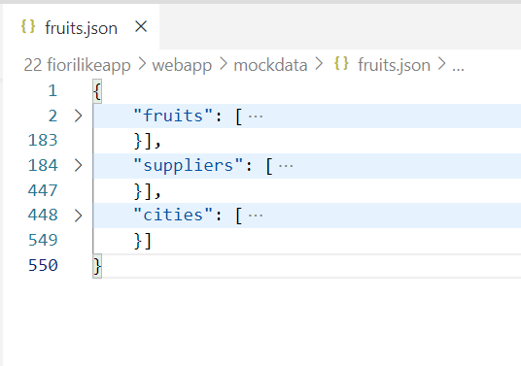
Binding List Items
Now we will bind the list form some demo data. But before we start, we need some demo data in json file. The data is provided in exercise as fruits.json.
It contains 3 entity sets:
fruits – name, color, type (neutral, citrus, alkaline),price, currency, unit, availability (available, discontinued, out of stock), season, photo (url from google) - 20
cities – name, state, famousFor, population, lat, lng -10
supplier – name, contactPerson, contactNo, sinceWhen, city, speciality :[“name of fruits”] -10

Slide 22
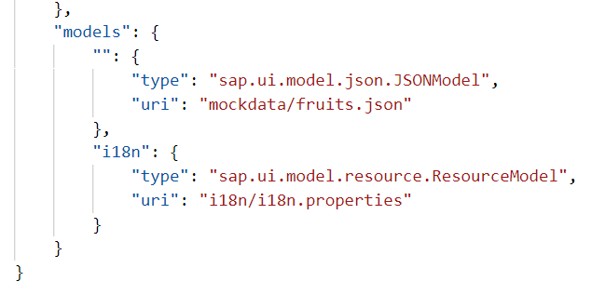
Model Instantiation
The app configures several data models that are used throughout the app to update the views or to store additional configuration options.
The service model and the resource bundle are instantiated automatically by the app’s component during startup and described in the first section. The local view models and helper models such as the device model are set up as JSON models and described in the second section.
Automatic Model Instantiation
The templates instantiate the service and resource model automatically using the following configuration entries in the descriptor. When the component of the app is initialized, these models will be made available under the configured name throughout the app.
An external service is defined in the dataSources section of the sap.app namespace. In the example shown below, we configure an OData with protocol version 2.0 and the alias "mainService" in the manifest.json file:

Slide 23
List Modes
The mode property defines the appearance of the left area of a list item.
Lists have properties and events and they contain list items that inherit from sap.m.ListItemBase, which provides navigation, selection and event features.
Delete
SingleSelect
01
04
only one list item can be deleted via provided delete button
Right-positioned single selection mode (only one list item can be selected).
01
04
MultiSelect
You can edit this text
SingleSelectLeft
02
05
02
more than one list item can be selected
05
Left-positioned single selection mode (only one list item can be selected).
03
06
None
03
06
SingleSelectMaster
no selection
Selected item is highlighted but no selection control is visible (only one list item can be selected).

Slide 24
Exercise: Object List Item with demo data
In this exercise we will Instantiate our model in Manifest.json and then bind the newly created model with the List in the view.
Along with that we will also use some formatter in the list.
Exercise code/resource:
View1.view.xml
manifest.json
fruits.json
formatter.js

Slide 25
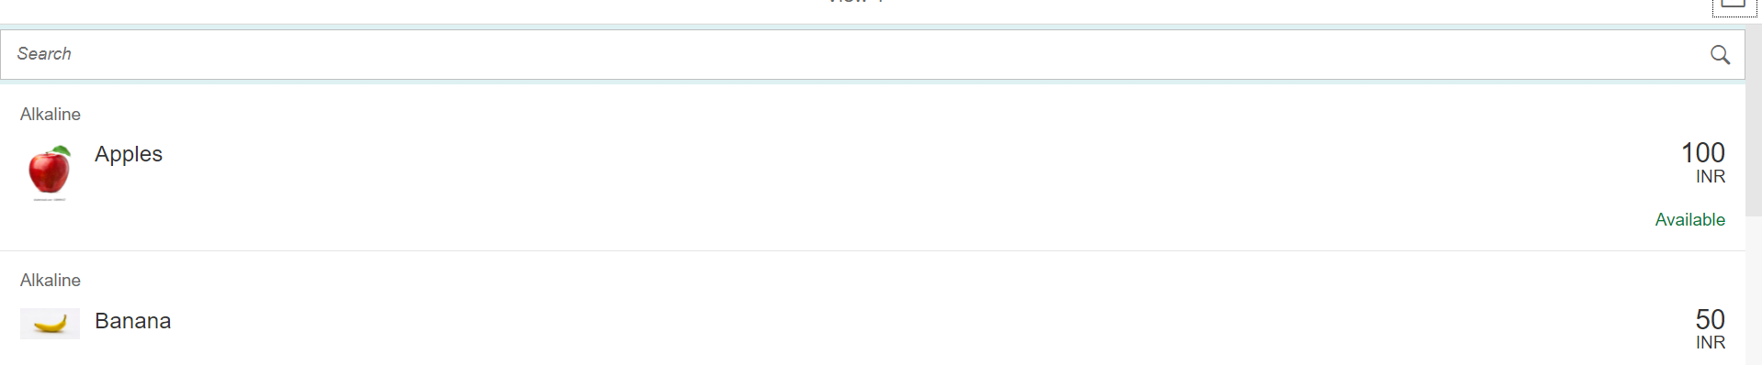
Exercise - Using Search Fields to Filter Data
Nowadays we come across many web pages that provide data in the form of lists or tables. These lists are enabled with search functionality, i.e., as the user types in into the search field and press enter then the data in the list is filtered according to the value in search field.
In this exercise we will implement the search functionality in our application to filter data in fruits list.
Exercise code/resource:
View1.view.xml
View1.controller.js

Slide 26
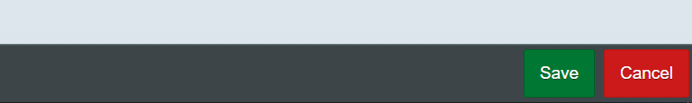
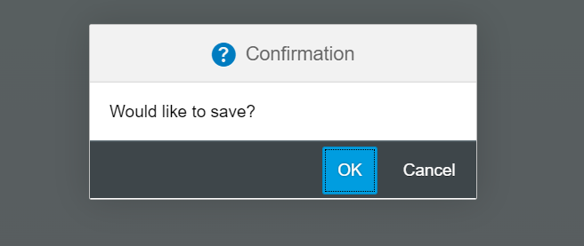
Exercise – Toolbar & Message Box
Toolbar:- A toolbar is a set of icons or buttons that are part of a software program's interface or an open window.
Toolbars have items such as Back and Forward buttons, a Home button, and an address field.
MessageBox: - The message box (sap.m.MessageBox) is a special dialog that allows you to display messages to the user. Compared to the message popover (sap.m.MessagePopover), you can use the message box to display messages that are not related to a field on the UI, such as technical errors.
In this exercise we will add a footer toolbar on the View2, in that toolbar we will also add to buttons and on click of that buttons we will open a MessageBox.
Exercise Code/Resource:
View2.view.xml
View2.controller.js
Header Toolbar
Footer Toolbar
Message Box

Slide 27
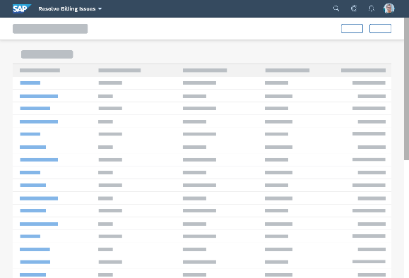
Introduction to Worklist Application
A worklist displays a collection of items a user needs to process. Working through the list usually involves reviewing details of the items and taking action. In most cases, the user has to either complete a work item or delegate it.
When to use:
Users have numerous work items and need to decide which ones to process first.
You want to give users a direct entry point for taking action on work items.
Users need to work with multiple views of the same content (for example, items that are “Open”, “In Process”, or “Completed”). You want to offer tabs for switching between views.
Detail View
List Page

Slide 28
Exercise: Work List Application
Now we will make over application a worklist application.
When we select a fruit in the list on the view1 the details of that fruit will be visible on the View2.
Exercise code/resources:
View1.view.xml
View1.controller.js
View2.view.xml

Slide 29

End of Day 9

Slide 30

Questions

Slide 31

Anubhav Oberoy

Slide 32


We’re committed to empower you to be
Most Desirable Resource
through powerful training solutions.
We build the workforce of the future.
250+
Corporate Clients
30,000+
Learners Trained
25000+
Learners Placed
FREE WEBINARS
Sign up for free webinars with industry experts every fortnight!
Enroll Now!
Contact us today!
https://anubhavtrainings.com/

Slide 33




More from AnubhavTrainings.com

Slide 34
Title
Content

